Slide 1

Fall Detection System Using Sensors Embedded In Smartphones
By,
Jathin Sreenivas,
Vineeth Bhat,
Vidya Gopalakrishnarao

Slide 2
Updated Flowchart and Sequence Diagram
Flowchart:
Removed FT1(Lower threshold).
Sequence Diagram:
Included Sensor related activity.

Slide 4
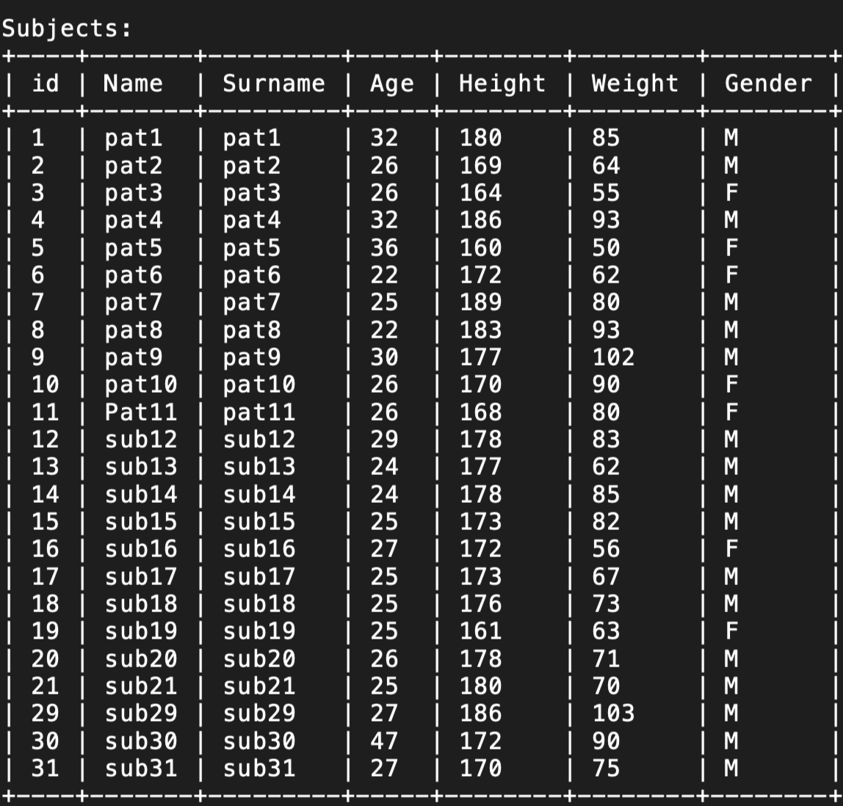
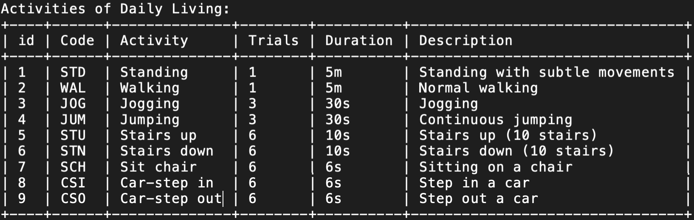
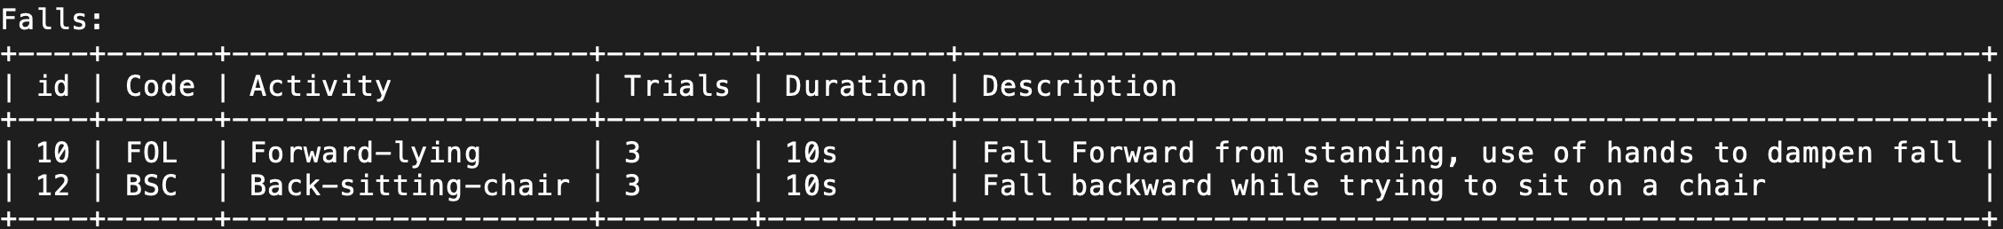
Testing
Test program to test the algorithm of fall detection.

Slide 5
Testing
Test 1: Sum vector(FT1) = 1.95g
Angular Velocity(FT2) = 1.52 deg/s
Tilt (FT3) = 60 degrees
Total cases of actual fall = 24 subjects * 2 types of fall
Total cases of non-fall (daily activities) = 9 subjects * 9 cases
Test 2: Sum vector(FT1) = 2.142g
Angular Velocity(FT2) = 1.52 deg/s
Tilt (FT3) = 60 degrees
Total cases of actual fall = 24 subjects * 2 types of fall
Total cases of non-fall (daily activities) = 9 subjects * 9 cases
 |  | Predicted
 |  | Fall | Non-Fall
Actual | Fall | 47 (True Positive) | 1 (False Negative)
 | Non-Fall | 33 (False Positive) | 48 (True Negative)
 |  | Predicted
 |  | Fall | Non-Fall
Actual | Fall | 47 (True Positive) | 1 (False Negative)
 | Non-Fall | 23 (False Positive) | 58 (True Negative)
Result: Sensitivity = 0.97
Specificity = 0.59
Result: Sensitivity = 0.97
Specificity = 0.71

Slide 6
References
H. W. Guo, Y. T. Hsieh, Y. S. Huang, J. C. Chien, K. Haraikawa and J. S. Shieh, "A threshold-based algorithm of fall detection using a wearable device with tri-axial accelerometer and gyroscope," 2015 International Conference on Intelligent Informatics and Biomedical Sciences (ICIIBMS), Okinawa, 2015, pp. 54-57, doi: 10.1109/ICIIBMS.2015.7439470.
G. Vavoulas, M. Pediaditis, E. G. Spanakis and M. Tsiknakis, "The MobiFall dataset: An initial evaluation of fall detection algorithms using smartphones," 13th IEEE International Conference on BioInformatics and BioEngineering, Chania, 2013, pp. 1-4, doi: 10.1109/BIBE.2013.6701629.
G. Vavoulas, M. Pediaditis, C. Chatzaki, E. G. Spanakis, M. Tsiknakis, The MobiFall Dataset: Fall Detection and Classification with a Smartphone, invited publication for the International Journal of Monitoring and Surveillance Technologies Research, pp 44-56, 2014, DOI:10.4018/ijmstr.2014010103.

